Slide 1


Name of the Product/Service /Project title/IDEA { Tagline if any }
Team Name
Team Members Details (Name, PRN)
Date:

Slide 2
1. Problem Statement What is the problem that you are trying to solve? What are the business opportunities your solution would fullfil?
Helping questions
State clearly the Pain points and insights from user research – how big/ pressing is the issue? Why is it important to solve the problem now?
Clearly define your problem statement
Customer Jobs to be done, how are they being done today
Pains
Gains
Use the data from slides – Research Plan, Study of AS IS, Stakeholder mapping, Observation Canvas, Empathy Map, Interviews etc.
Any further problem/pain/issue related information

Slide 3
1.1 Competition & Barrier To Entry
Helping questions
Market Study and Research – Statistics (Facts & Data) and Scenarios
How do the current available solutions compare with your solution?
How easy is it to replicate your solution?
How difficult for you to enter into the market? What are the barriers and difficulties that you will face?
Who are your competitors, how many, how tough is the competition?

Slide 4
1.2 Target Market
Helping questions
Customer Segmentation (Clearly mention your target audience). Who are your customers?
How big is your market: The size of the market vs the percentage you are targeting.
A granular profiling of your customer (For ex: age, geography, purchase habits, personal traits etc.)
What channels will you use to get to this market?

Slide 5
2. Solution (Idea/Innovation)
Helping questions
Clearly mention your ideas (Top ideas from Ideation tools) and how they solve the pain points of user/stakeholder
Working principle/architecture, technology, components, process going to be used in your idea
Briefly explain your final solution – Prototype/Product/Service/System/Process
Uniqueness, innovation, novelty in your idea
Use the slides from Ideation, Conceptualization, Prototype & Test phase

Slide 6
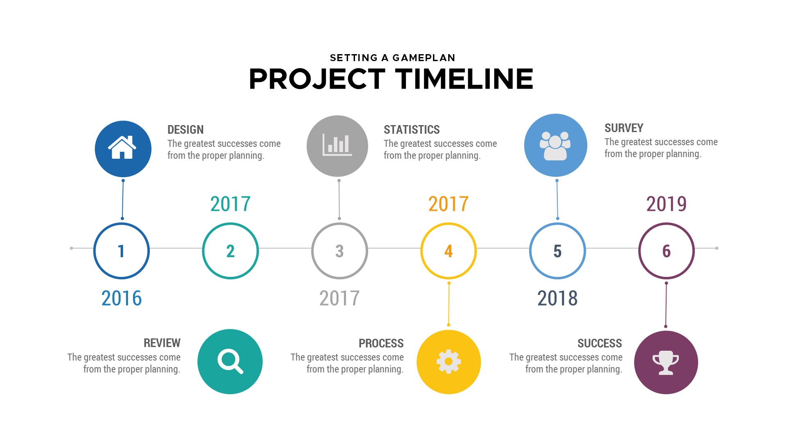
3. Time line (Optional – will carry extra weightage)
Progress till date
Future Planning

Slide 7
3. Value Proposition (USP) What characteristics make your solution a “never-before” solution
Helping questions
Customer Jobs to be done, how are they being done today
Pains Relievers
Gains Creators
How is your solution the best fit for the customer’s pain?
What value do your solution add to customer/user?
How are we different and unique than competitors? – Competitor analysis along with existing solutions if any
Strategy of creating Entry barrier for your competitors
Share the underlying magic
Explain through Value Proposition Canvas

Slide 8
4. Business Model Canvas (BMC)
Helping questions
Clearly explain each building blocks of BMC through Business Model Canvas
Operational Processes and structure of the company
3 to 5 year projections (Excel sheet)
Financial analysis (Cost structure, Revenue model) (Excel sheet)
How much funding is required and WHY?
Where and how are you planning to use these funding?
Fund required for pilot testing, Launch, Growth etc.
How do you make money off your solution? (Ex: subscription Model, Direct Sales, Ad-based)

Slide 9
5. Fund Requirement
Prototype Elements, Minor Work, Lab development & Facility required
Approx. Costing for each element
Cost break-ups: Heads, Operational, Salaries etc.
Other details if any
Explain how would you utilize these funds and why?
(Mention realistic numbers for expected funding)

Slide 10
6. Three years Financial projections (Optional – will carry extra weightage)
Financial Analysis & Revenue Model
Fund required for pilot testing, Launch, Growth etc.
CAPEX (Capital Expenditure)
OPEX (Operational Expenditure)
Revenue Streams

Slide 11
7. Team
Introduce your founding members & Key People
Along with credentials, Their roles & responsibilities in the venture (you can mention why they’re involved)
Exhibit unity in thinking, in strategy
Add Boastable Achievements
Future Hirings

Slide 12






Thank you
innodesk1@gmail.com
91 - 909 909 0464
Follow us on:
/innodeskzone

Slide 13
General Guidelines
Dos
Don’ts
Precise Points only – Support with statistics
Be Visual – Screenshots, Images, Charts, Animations
Max. 8-10 slides
Be Realistic and honest
Be descriptive and just read slides
Have more slides for single purpose

Slide 14
Remember
Validate every possible slide with data. Numbers don’t lie.
It is usually not a great idea because you think so, but because your target market said so.
Don’t be afraid to recognize that it will not work and will change direction or will drop it completely. The right idea might be the next one. Iterations is an important part of journey.
Getting funded does not mean success! Pitch less like a presentation, more like a story!

Slide 15


